Slide 1

CureMeNow - Health Care Website
Sakshi Gunjal - 20104106
Ashmina Dangat - 20104052
Neha Chaudhary - 20104134
Project Guide
Ms. Mansi Choche

Slide 2
Contents
Introduction
Objectives
Scope
Literature Survey
Proposed System
Project Outcomes
Block Diagram
Use Case/DFD
Technology Stack
Suggestions in Review-1
Implementation
Conclusion and Future Scope
Reference

Slide 3
1. Introduction
CureMeNow is a user-friendly healthcare website most prominently used during emergencies and for general purposes. Its main aim is to provide a straightforward solution to the user considering their health problems.
Problem Identified :
For every minimal health problem, we tend to go to google for a solution which is only partially right.
Solution Proposed :
CureMeNow provides a simple and straight solution for your diseases or problems. It provides medication, home remedies and gives you locations of nearby medicals.

Slide 4
2. Objectives
To develop a user-friendly portal that can be accessible anytime and anywhere.
To provide proper immediate medications.
To help people reach medical stores in case of emergency.
To reduce the efforts of users.
To reduce stress among the users regarding their health issues.
To provide preventive health measures.
To provide better medication management and reduce cost.
To improve clinical decision-making.
To ensure better quality of care and research.

Slide 5
3. Scope
To deploy adaptable real-life applicable model.
Our website targets all age groups except children.
Users can locate medical stores and hospitals near them.
Patient-centric value services.
Anyone can get various home remedies that are worth trying for better living.
Anyone can read blogs related to health problems easily.

Slide 6
4. Literature Survey
Case 1: “Study on information system of health care services management in hospital” Author(s): Daiping Hu, Antai Sch. of Manage., Shanghai Jiaotong Univ., China Weiguo Xu; Huizhang Shen; Mengyu Li. Services Systems and Services Management.It aims at improving quality of services, identifying cost reduction areas, analyses and evaluate/rate heath care services
Case 2: “Specification of a Reference Model for the Domain Layer of a Hospital Information System” by Gudrun Hübner-Blodera, Elske Ammenwertha , Birgit Brigl b , Alfred Winter. It was based on the aim of creating a whole hospital management system.
Case 3 : “Developing Effective Hospital Management Information Systems: A Technology Ecosystem Perspective”, by Dr Christopher Bain MBBS. The author of this paper focuses more on needs of hospital manager and the ecosystem in which he/she operates.

Slide 7
5. Proposed System
1. Provides accurate solutions to any health problems user face.
2. Provides facility to search hospitals and medicals nearby.
3. User can go through a blog section for various health related blogs.
4. User can shop and pay for medicines at ease on shop page.
5. User can contact by various social media platforms, email or on contact us page.
6. To give doctor’s appointment. [Future Implementation]
7. To track products which are out for delivery. [Future Implementation]

Slide 8
6. Project Outcomes
User-friendly portal that can be accessible anytime and anywhere.
User can get recommendations on specific health problems.
Users can answer the questionnaire and get their medications.
Users can get 24*7 services for medical emergencies.
Users can shop for medicines online.
Users can make payments online and cash on delivery.
Users can search for nearby medicals and get directions.
Users can read many informative blogs about healthcare.
Users can contact the support system if they face any issues.

Slide 9
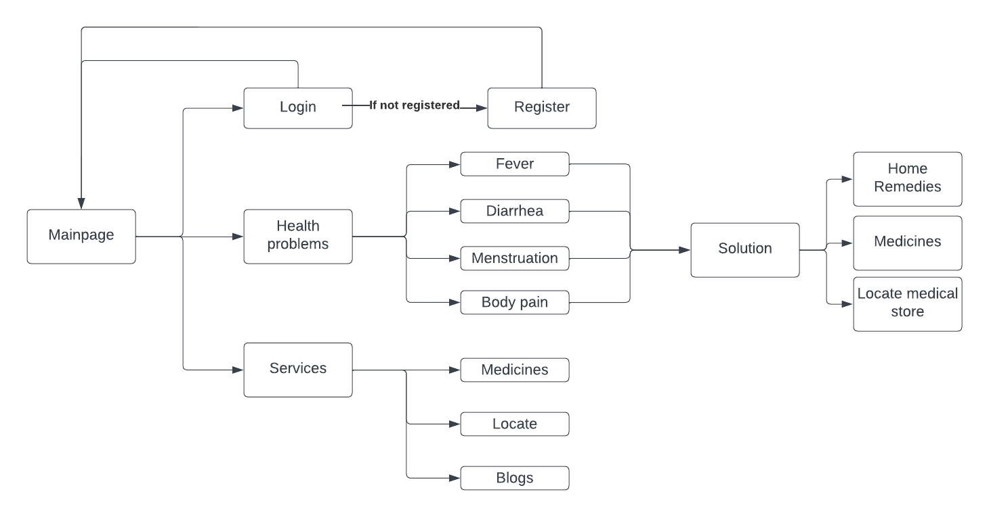
7. Block Diagram
Block diagram for CureMeNow Healthcare Website

Slide 10
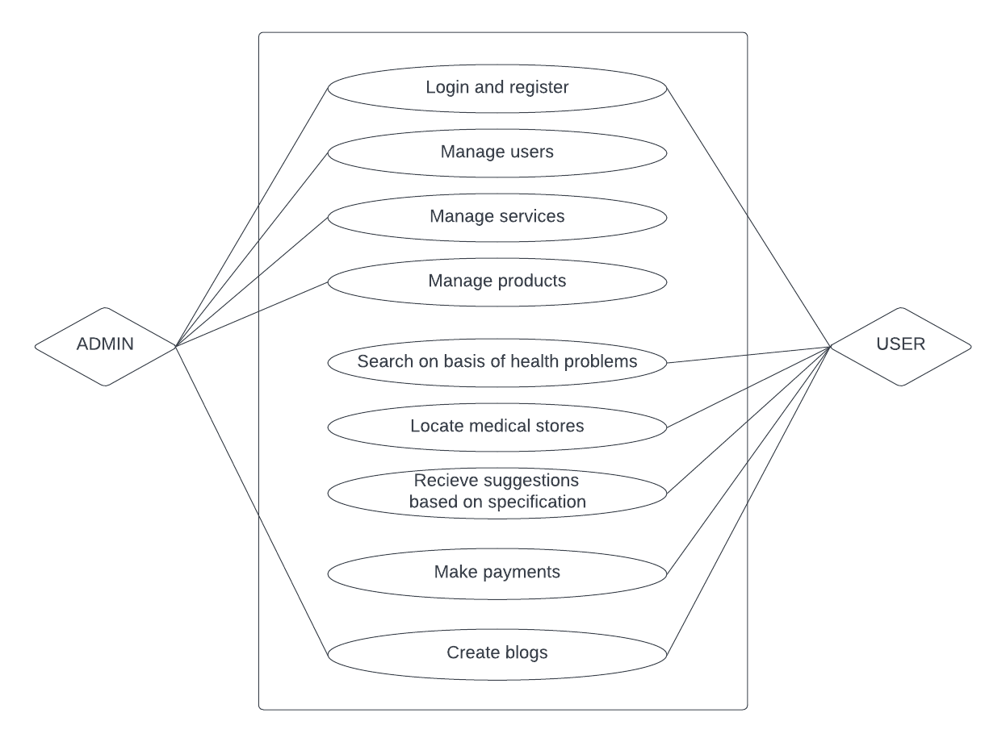
8. Use Case diagram
Used case diagram of CureMeNow Healthcare website

Slide 11


9. Technology Stack
Write what you have planned to develop front end ( GUI ) & Backend (Database if applicable)
HTML
CSS
JavaScript
PHP
APIs Used :
Google maps (for directions)
Cash free website (for payment)

Slide 12
10. Suggestions in Review - 1
1. To add dummy doctor.
2. To connect with database.
3. To improve GUI.

Slide 13
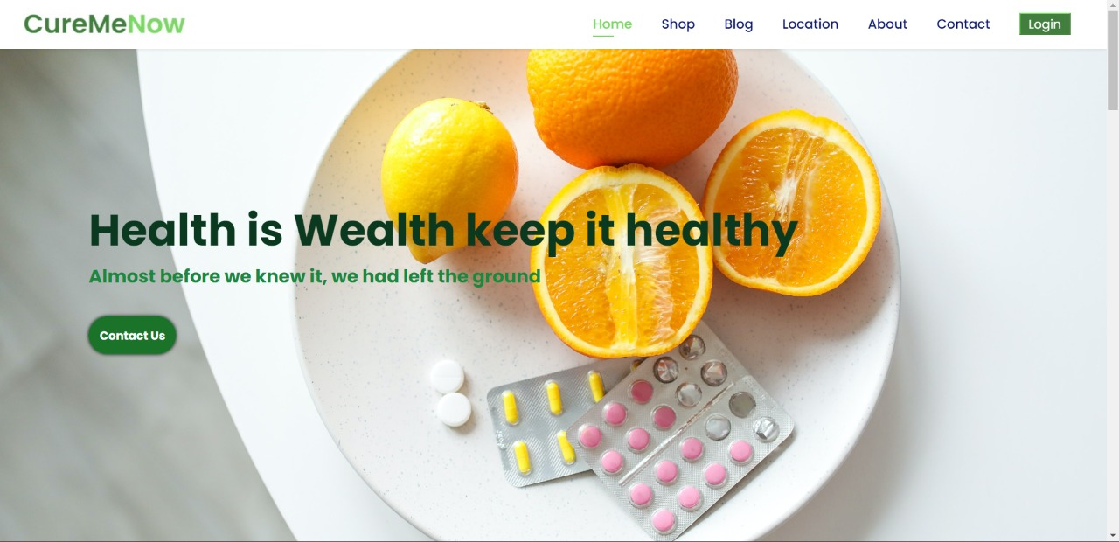
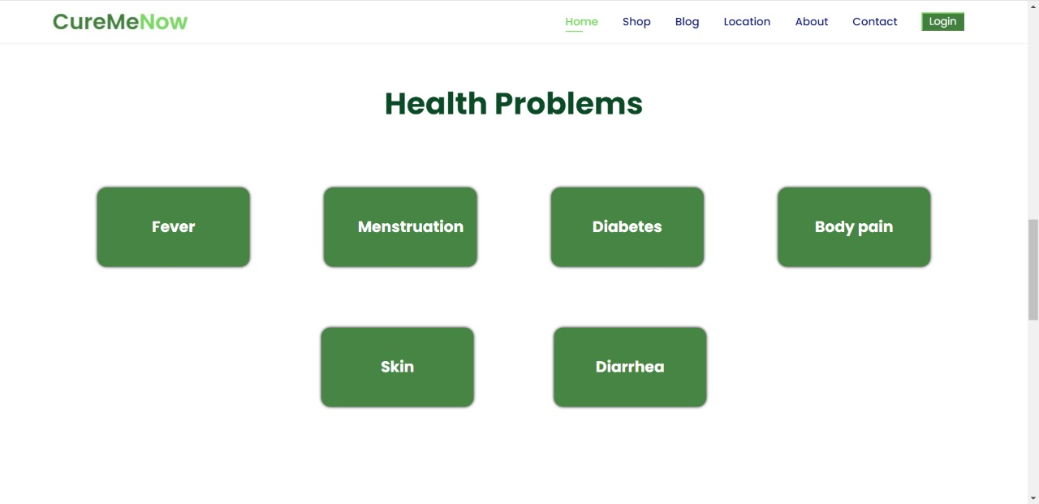
11. Implementation

Slide 14
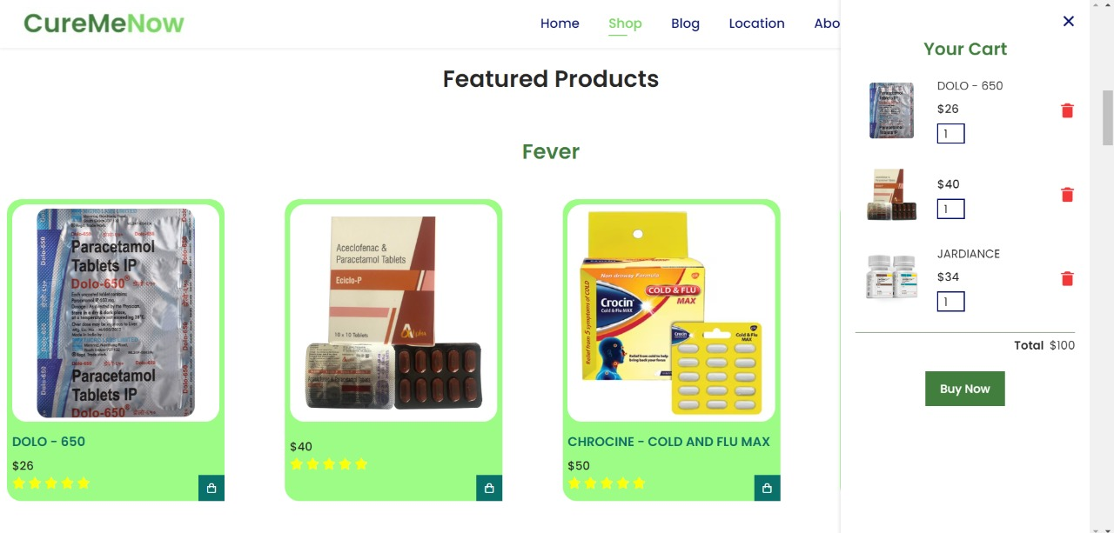
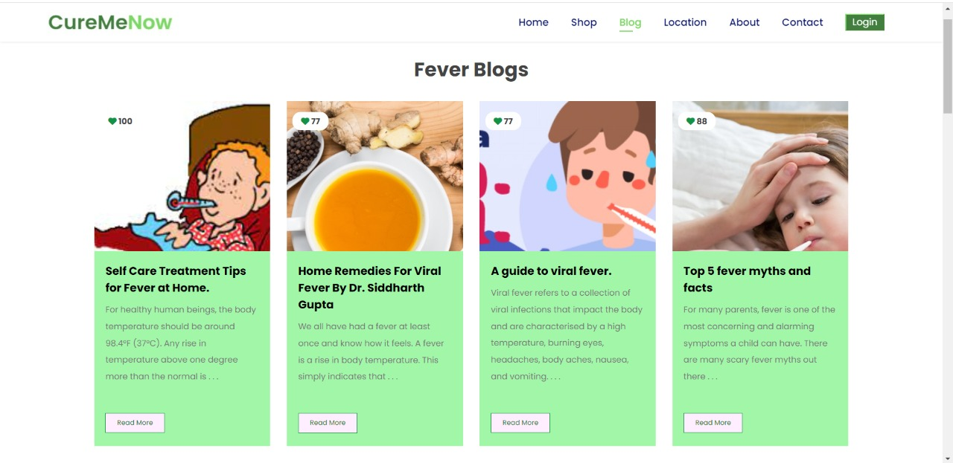

Slide 15
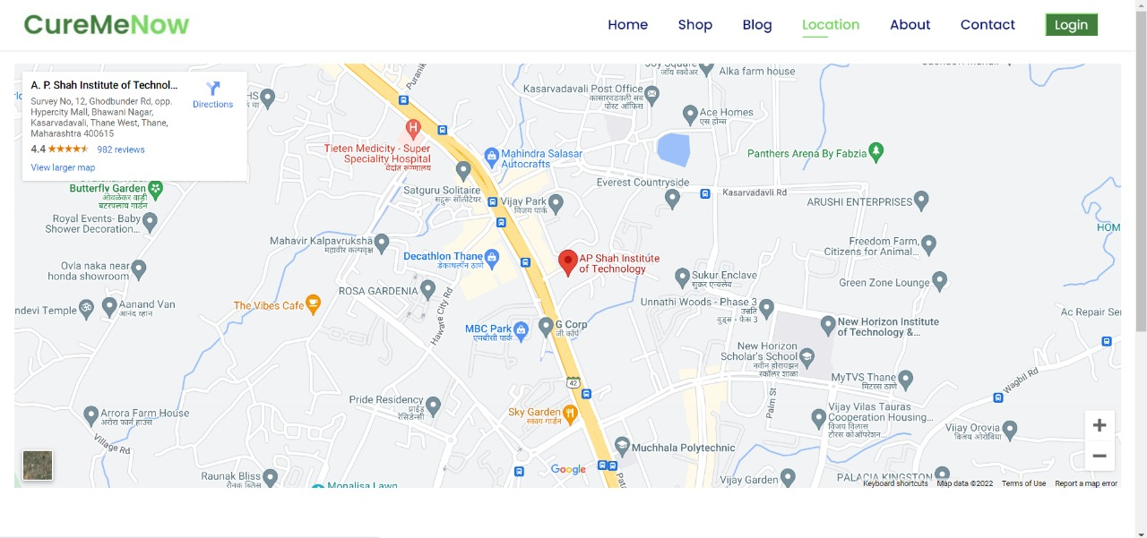
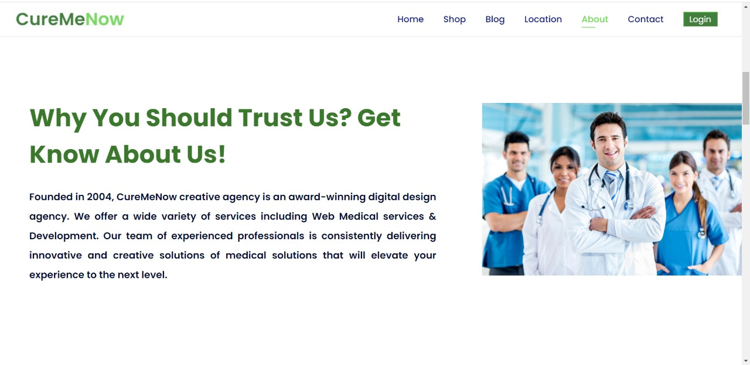

Slide 16
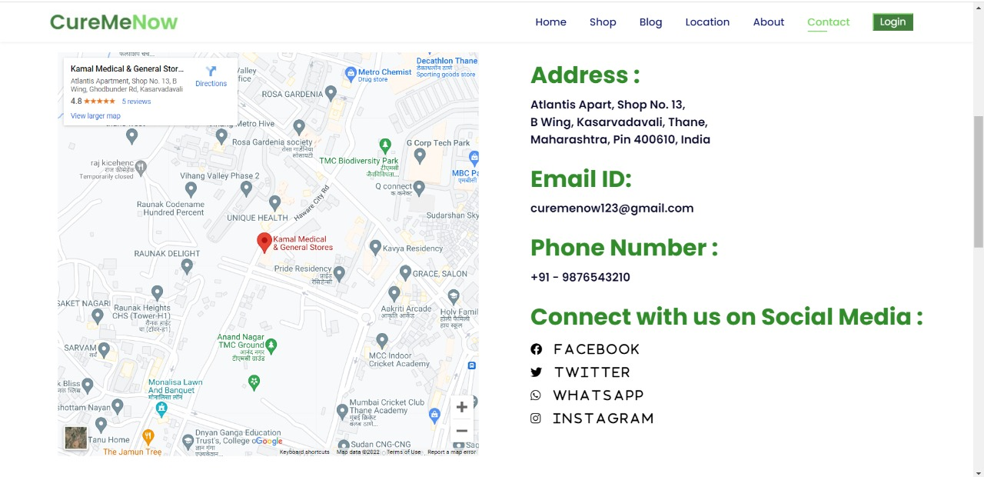
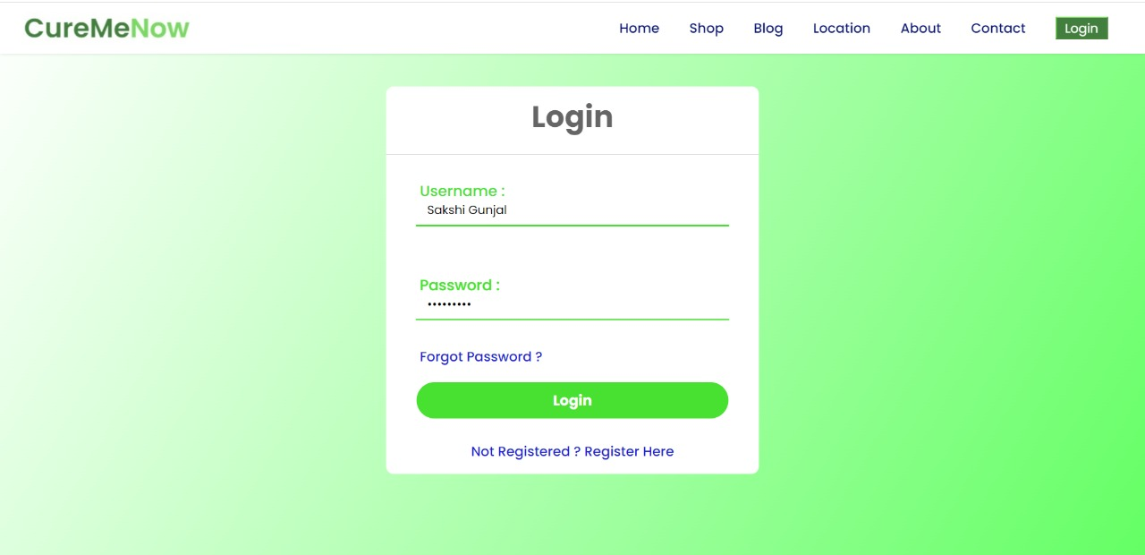

Slide 17
12. Conclusion and Future Scope
Conclusion :-
Developing the medical system software is a great opportunity to create the distinct, efficient and fast delivering healthcare model. Implementation of medical website project helps to provide user communication, manage financial and human resources, and market medical services.
Future Scope :-
1. Solutions to more health problems.
2. To give doctor’s appointment.
3. To track products which are out for delivery.

Slide 18
References
1. Reasearch Papers
https://www.researchgate.net/publication/300118919_Health _related_smartphone_applications_a_literature_review
2. Website reference
https://www.mayoclinic.org/
3. YouTube Reference
https://www.youtube.com/watch?v=18Jvyp60Vbg
4. Drive link for Research Papers
https://drive.google.com/drive/folders/1aL6-dLiiMCg4oX6- bEj4ztrS72_gVPn4

Slide 19
Thank You...!!

